Slide 1


1
PRESIDENCY UNIVERSITY
School of Artificial Intelligence and Advanced Computing

Slide 2

CSS7102- Mini Project Review-2
CIVIC-VOICE An AI .Assistant for Multi-Channel Citizen Feedback Analysis in Public Services
Batch Number: CAI-21
Under the Supervision of,
Roll Number
20231CAI0117
20231CAI0120
20231CAI0115
Student Name
Inchara KR
Peddi Reddy Tejaswini Sahana Haragapure
Dr. Jagadevi Bakka Assistant Professor
School of Computer Science and Engineering Presidency University
Name of the Program: B.Tech
Name of the HoD: Dr. Zafar Ali Khan N
Name of the Program Project Coordinator: Dr. Jagadevi Bakka
Name of the School Project Coordinators: Dr. Sampath A K

Slide 3
Content
Problem Statement
Abstract
Github Link
Objective
Analysis of Problem Statement
Timeline of the Project
References
Literature Survey

Slide 4
Problem Statement Number: 40
Organization: Public Service Organizations (Government Agencies)
Category : Software
Problem Description:
Public agencies receive citizen feedback through emails, social media, and surveys but often analyze these in silos. An AI assistant that unifies feedback, detects themes, and highlights emerging issues would improve responsiveness. The solution should focus on sentiment and topic modeling across channels, equity-aware treatment of minority voices, and dashboards for officials to track concerns over time.
Difficulty Level: Medium–High

Slide 5
Abstract:
CiviVoice AI is an AI-powered assistant designed to analyze citizen feedback received through multiple channels such as emails, surveys, social media, and online feedback platforms. Public agencies often handle these sources independently, making it difficult and time-consuming to identify recurring complaints, citizen sentiment, and emerging public-service issues. The proposed system integrates heterogeneous feedback into a unified platform and applies Natural Language Processing (NLP) techniques for text preprocessing, sentiment analysis, and topic detection. The system further identifies frequently occurring and emerging issues, assigns priority levels, and presents the results through an interactive dashboard. By converting unstructured citizen feedback into structured and actionable insights, CiviVoice AI aims to support public-service officials in understanding citizen concerns, prioritizing critical issues, and improving responsiveness and decision-making.

Slide 6
Github Link
Github Link: https://github.com/inchara-k-r/AI-Assistant-for-Multi-Channel-Citizen-Feedback-Analysis

Slide 7
OBJECTIVES
Multi-channel integration
To develop a unified platform for collecting and integrating citizen feedback from at least three channels, such as email, surveys, and social media.
Sentiment analysis
To automatically classify citizen feedback into positive, neutral, and negative sentiment categories using NLP-based machine learning/transformer models.
Topic and issue detection
To identify recurring service-related topics and emerging issues from large volumes of unstructured citizen feedback using topic-analysis techniques.
Issue prioritization
To assign priority levels to identified issues based on factors such as sentiment severity, frequency, and urgency, enabling officials to focus on critical concerns.
Decision-support dashboard
To develop an interactive dashboard that visualizes feedback trends, sentiment distribution, major topics, emerging issues, and priority complaints for public-service decision-making.

Slide 8
Analysis of Problem Statement
Technology Stack Components:
Component | Technology | Purpose
Frontend | Streamlit / HTML, CSS, JavaScript | User interface and dashboard
Backend | Python, Flask (or FastAPI) | API development and application logic
Programming Language | Python | Core development
NLP & AI | Hugging Face Transformers, BERT, NLTK, spaCy | Text preprocessing, sentiment analysis, summarization
Machine Learning | Scikit-learn | Complaint classification and model evaluation

Slide 9
Analysis of Problem Statement (contd...)
Component | Technology | Purpose
Database | MongoDB | Store citizen feedback and analysis results
Data Processing | Pandas, NumPy | Data cleaning and manipulation
Visualization | Plotly, Matplotlib | Graphs, charts, and analytics
Development Environment | Jupyter Notebook, VS Code | Model development and coding
Version Control | Git & GitHub | Source code management and collaboration
Deployment (Optional) | Render / Railway / Streamlit Cloud | Deploy the web application

Slide 10
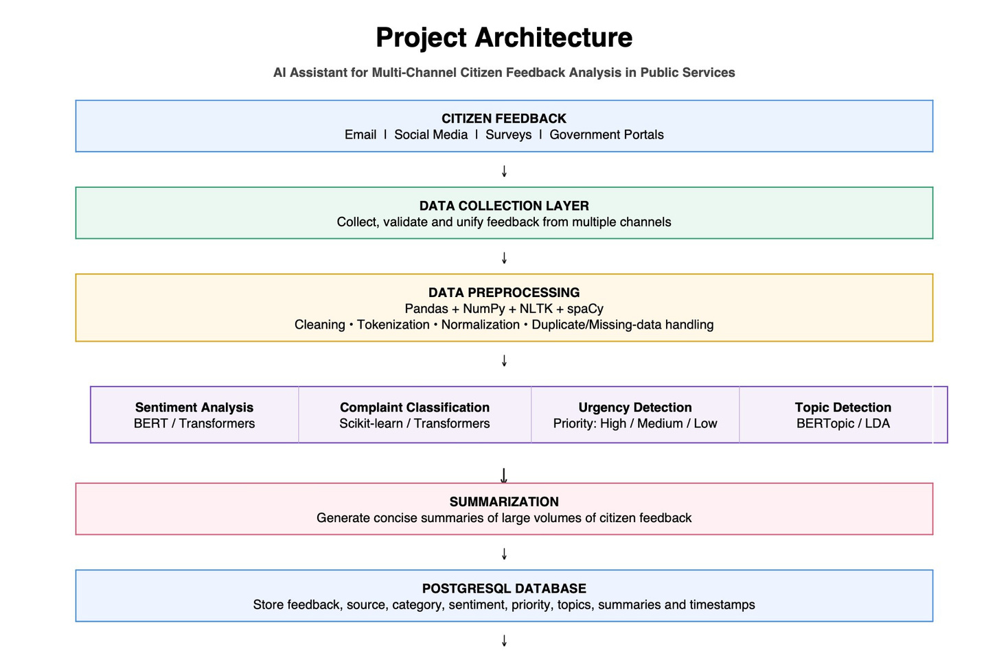
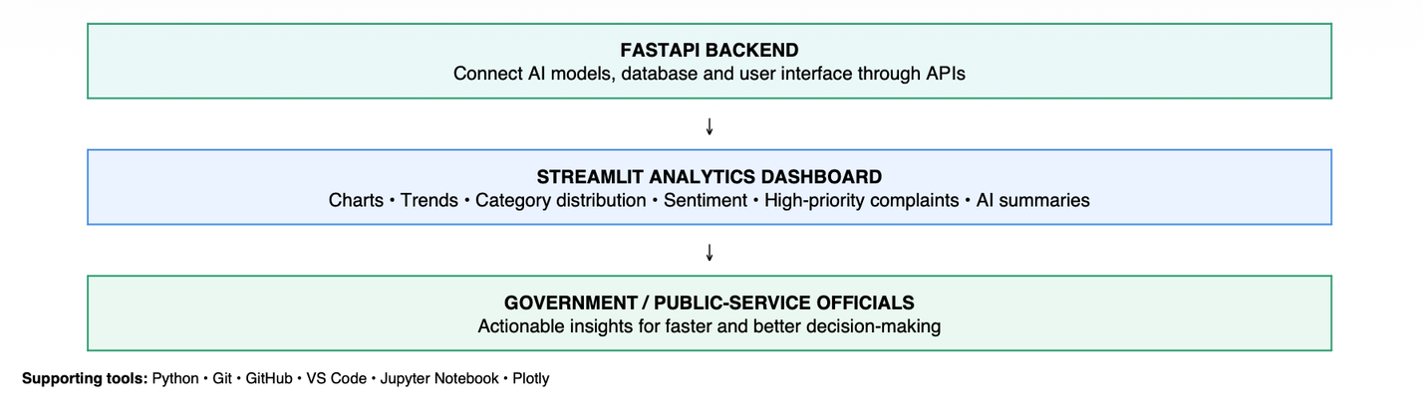

Slide 11
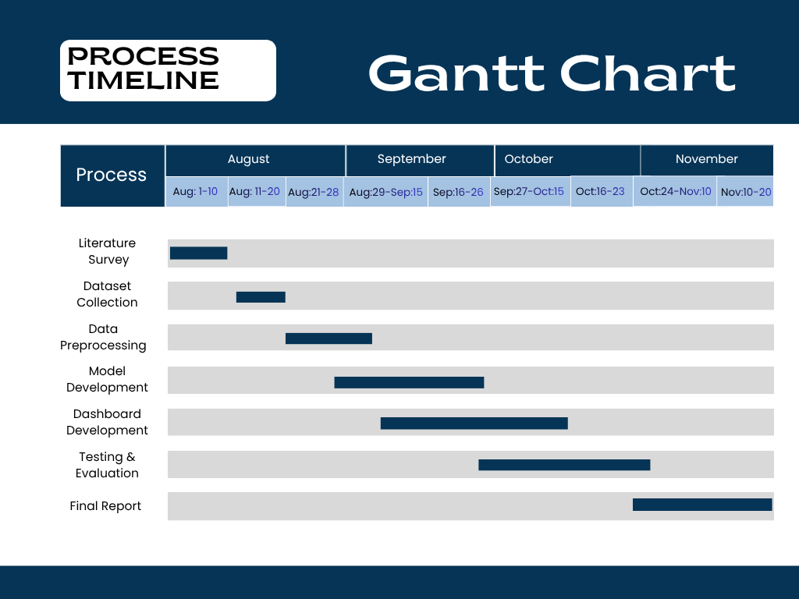
Timeline of the Project (Gantt Chart)

Slide 12
References (IEEE Paper format)
Sarvestani, M. (2025). An NLP-based framework for sentiment and topic analysis of citizen feedback on U.K. government mobile applications. IEEE Access, 13, 210360–210377.
https://doi.org/10.1109/ACCESS.2025.3641669
Airlangga, M. C., et al. (2023). Understanding citizen feedback of Jakarta government super app: Leveraging deep learning models. In 2023 IEEE International Smart Cities Conference (ISC2) (pp. 1–6). IEEE.
https://doi.org/10.1109/ISC257844.2023.10293572
Alkraiji, A. I. (2020). Citizen satisfaction with mandatory e-government services: A conceptual framework and an empirical validation. IEEE Access, 8, 117253–117265.
https://doi.org/10.1109/ACCESS.2020.3004541
S. K., A. Ravikurnar, V. R C., A. Reddy D., A. K. M. and S. K.P., "Sentiment Analysis of Indian Languages using Convolutional Neural Networks," 2018 International Conference on Computer Communication and Informatics (ICCCI), Coimbatore, India, 2018, pp. 1-4,
https://doi.org/ 10.1109/ICCCI.2018.8441371.

Slide 13
G. Chauhan, S. Puri and R. Nahta, "Analysis of Government Flagship Programs using Public Feedbacks," 2023 2nd International Conference for Innovation in Technology (INOCON), Bangalore, India, 2023, pp. 1-7,
https://doi.org/10.1109/INOCON57975.2023.10101351
I. H. Hafidz, A. Sulistya and B. R. Lidiawaty, "Sentiment Analysis of Public Complaints: A Machine Learning Comparison of SVM, Naive Bayes, Random Forest, and XGBoost," 2025 International Conference on Advancement in Data Science, E-learning and Information System (ICADEIS), Bandung, Indonesia, 2025, pp. 1-6,
https://doi.org/10.1109/ICADEIS65852.2025.10933382
C. Nagesh, B. Divyasree, K. Madhu, T. Allisha, S. Datta Koushlk and P. Naresh, "Enhancing E-Government through Sentiment Analysis: A Dual Approach Using Text and Facial Expression Recognition," 2024 International Conference on Science Technology Engineering and Management (ICSTEM), Coimbatore, India, 2024, pp. 1-6,
https://doi.org/10.1109/ICSTEM61137.2024.10560678
G. A. Sandag, E. H. E. Soegiarto, L. Laoh, A. Gunawan and D. Sondakh, "Sentiment Analysis of Government Policy Regarding PPKM on Twitter Using LSTM," 2022 4th International Conference on Cybernetics and Intelligent System (ICORIS), Prapat, Indonesia, 2022, pp. 1-6,
https://doi.org/ 10.1109/ICORIS56080.2022.10031474.

Slide 14


